Slide 1




No Malaria
Malaria

Slide 2

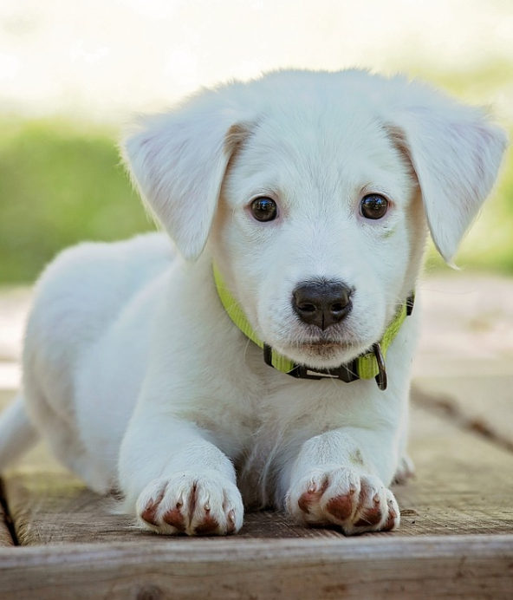

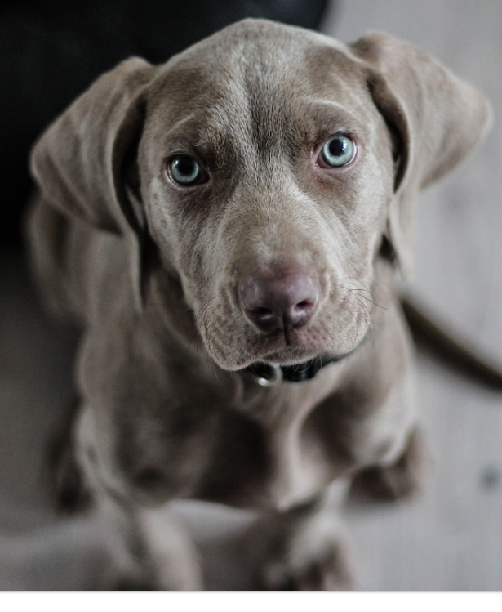
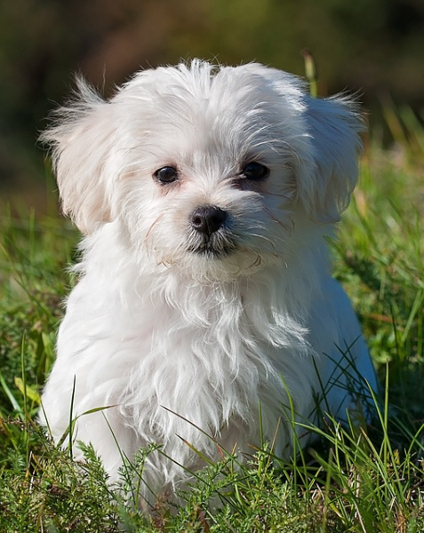
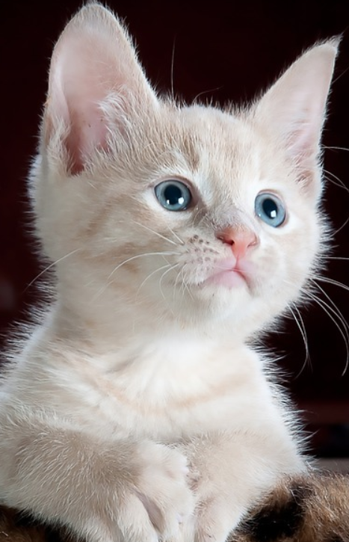
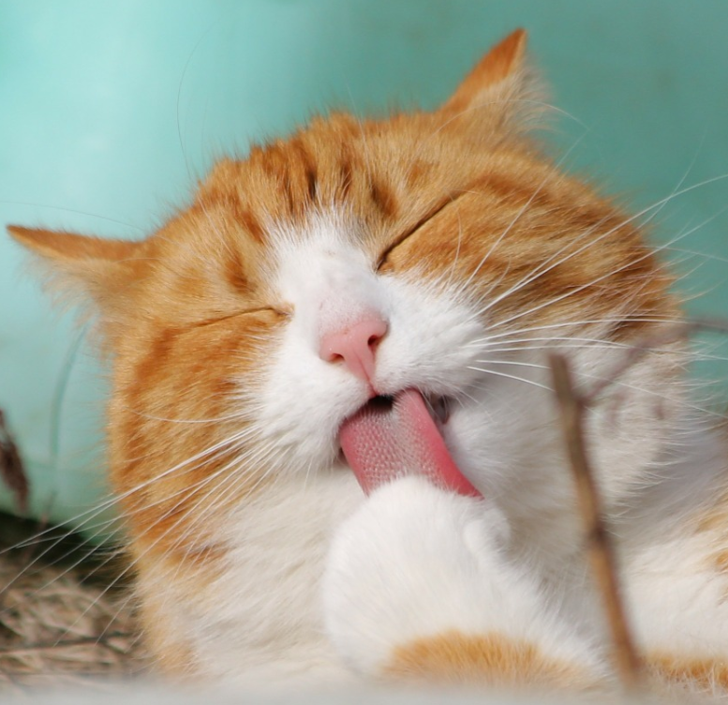
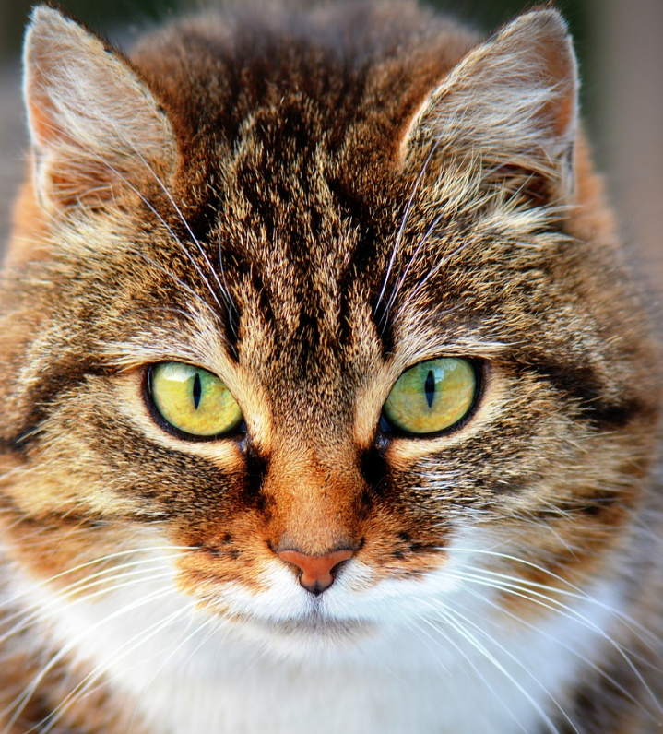
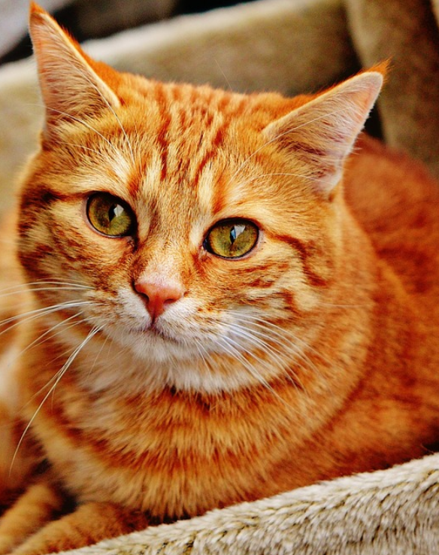
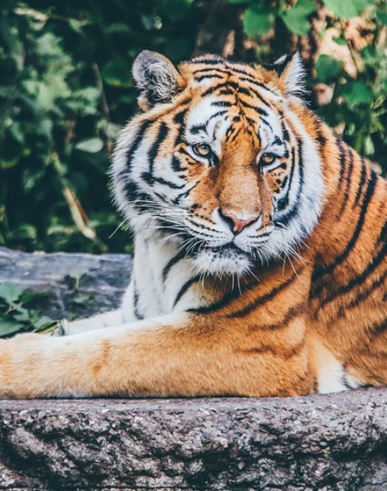
Real: dog
Pred: dog
Real: dog
Pred: dog
Real: dog
Pred: dog
Real: dog
Pred: dog
Real: dog
Pred: cat
Real: cat
Pred: cat
Real: cat
Pred: cat
Real: cat
Pred: cat
Real: cat
Pred: cat
Real: cat
Pred: cat

